Slide 1
Bulk Wheat Seeds Classification using Hyperspectral Imaging and 3D-CNN’s
M.Tech. Thesis
Supervisor
Prof. R. Balasubramanian
Student
Shitiz Goel (23566013)

Slide 2
Index
Introduction
Introduction to Hyperspectral Images
Problem Statement
Data Preparation
Dataset Overview
Data Preparation
3D CNN Models
Introduction to 3D CNN’s
3D ConvNeXt Model
3D DenseNet Model
3D ResNet Model
4. Band Selection Techniques
BSNet-Conv
DARecNet-BS
TAMSRecNet
SBAN
5. References

Slide 3
Introduction

Slide 4
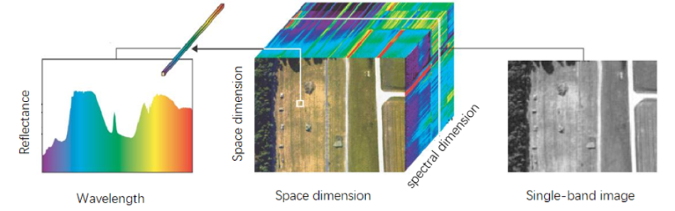
Introduction to Hyperspectral Images
A hyperspectral image is a type of digital image that captures the light reflected from objects across a wide range of wavelengths (Typically in the Visible Light & Near-Infrared Spectrum i.e. 400-1100 nm).
It is generally visualized as a 3D cube, with two spatial dimensions (x, y) and one spectral dimension (wavelength or λ).
It contains hundreds of channels per image usually known as spectral bands.
The spectra of each object is unique like our fingerprints which is the key reason for using hyperspectral images. E.g. Real vs Artificial Gold.
Figure 1 – A Hyperspectral Image visualized as 3D Cube [10a]

Slide 5
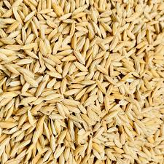
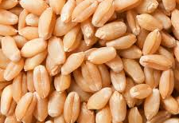
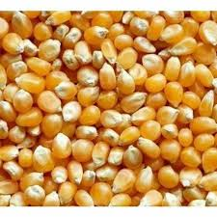
Problem Statement
Problem Statement - Classification of a large variety of seeds of any particular crop like rice, wheat, maize etc. using Hyperspectral Imaging and 3D CNN’s.
Rice Seeds
Wheat Seeds
Maize Seeds
Figure 2 – The seeds of different crops [10b]

Slide 6
Data Preparation

Slide 7
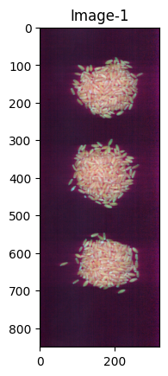
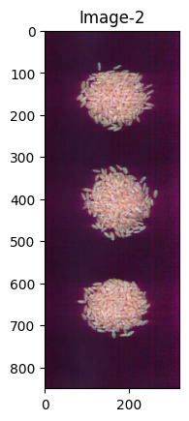
Dataset Overview
Wheat Variety RAJ3765_K_22
Dataset Description
The dataset contains 50 varieties of wheat seeds.
For each variety, we have two hyperspectral images having dimensions 850 x 320 x 168 as shown in Fig 3.
Each image has 3 circular regions of bulk wheat seeds.
Figure 3 - Two Hyperspectral Images of one wheat variety

Slide 8
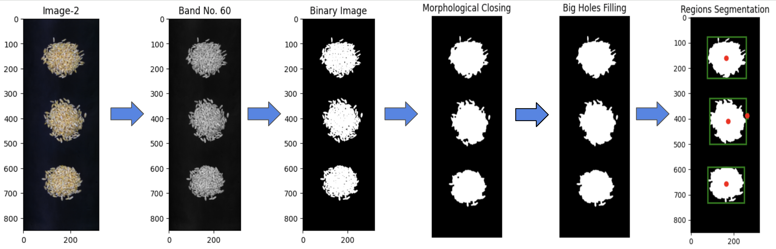
Data Preparation
1. Extraction of Seed Region Boundaries
Removed first 14 and last 7 noisy bands to get 147 spectral bands from 168.
Selected a single band (Band-60) and obtained corresponding binary image using Otsu Thresholding technique.
Applied Morphological Closing Operation to fill up the small holes in binary image.
Filled the remaining big holes to figure out the seed regions clearly.
Extracted the region centers and dimensions to obtain final boundary boxes.
Figure 4 - Steps involved in Circular Seed Regions Segmentation from each HSI Image

Slide 9
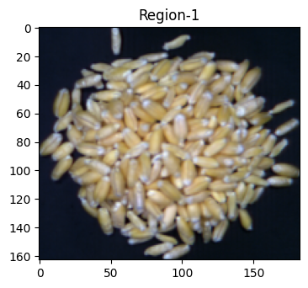
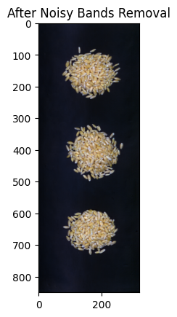
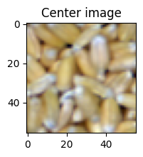
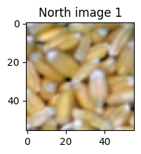
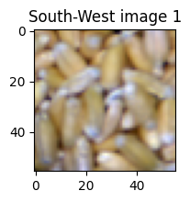
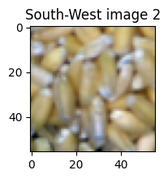
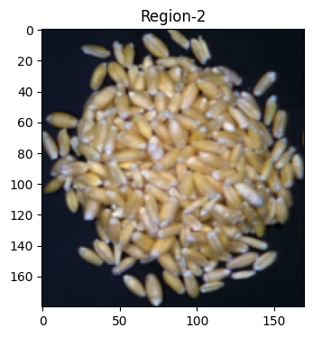
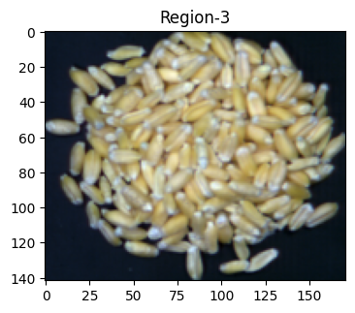
Data Preparation
2. Separation of seed regions from the original image
The boundaries extracted in Step-1 are used to extract each seed region separately from the original hyperspectral image.
……
Figure 5b - 56 x 56 x 147 sized cropped images
3. Cropping of small and equal sized images from each region
From each region, 17 small images having dimensions 56 x 56 x 147 are cropped using procedure described in next slide.
Figure 5a - Extraction of individual regions from the hyperspectral image.

Slide 10
Data Preparation
Procedure for extracting small images (56x56x147) from each region
One central image is first cropped.
Then, window is shifted by 18-18 units in each of NEWS directions 2 times.
Finally, window is shifted by 11-11 units diagonally in each four directions 2 times.
So, total (1+8+8) = 17 images are extracted from each region.
N
11
18
W
E
S
Figure 6 - Process to extract images from each circular region

Slide 11
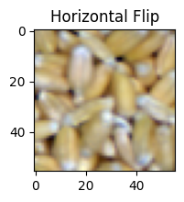
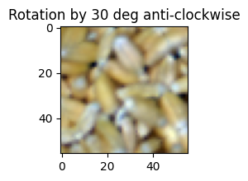
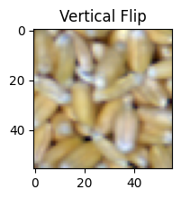
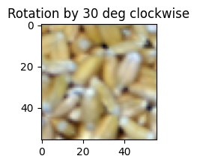
Data Preparation
4. Data Augmentation
Each of the 56x56x147 sized images are subjected to Horizontal Flip, Vertical Flip and Rotation (+30 degree, -30 degree).
From each region, we get 17+(17x4) = 85 images.
For each variety, we get 85x6 = 510 images.
In total, 510x50 = 25,500 images.
Figure 7 – Augmented Images

Slide 12
Data Preparation
5. Train-Test-Validation Split
First 2 regions from each image are taken for training.
Last region from image-1 is taken for validation.
Last region from image-2 is taken for testing.
Train-Test Split RAJ3765_K_22
Train
Validation
Total (56x56x147) Images after date preparation – 25,500
Train images – 17,000
Test images – 4,250
Validation images – 4,250
Test
Figure 8 – Train Test and Validation Split for each variety

Slide 13
3D CNN Models

Slide 14
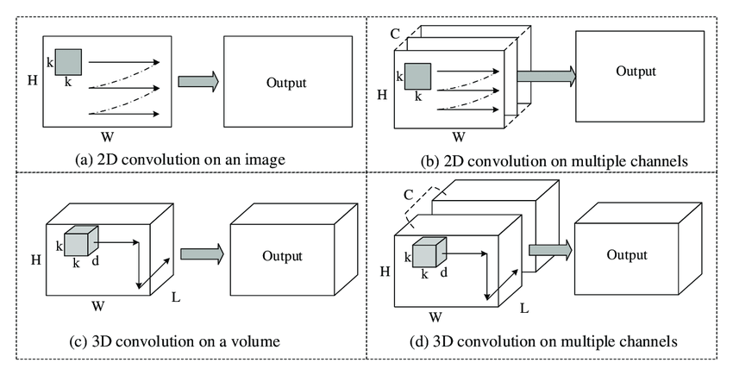
Introduction to 3D CNN’s
2D CNN
Here, each channel is 2D.
Convolutions in spatial (x-y) dimensions only.
Input can be 2D/3D. Output is 2D.
3D CNN
Here, each channel is 3D.
Convolutions in spatial and spectral (x-y-z) dimensions.
Input can be 3D/4D. Output is 3D.
Figure 9 – 2D and 3D convolutions on single and multiple channels

Slide 15
3D-ConvNeXt Model
ConvNeXt-T | Original 2D- ConvNeXt-T | Output size of 2D-ConvNeXt-T | 3D-ConvNeXt | Output size of 3D-ConvNeXt
input |  | 224 x 224 x 3 |  | 56 x 56 x 147 x 1
stem | 4×4, 96, stride 4, padding 0 | 56 x 56 x 96 | 4x4x4, 24, stride (4,2,2), padding 1 | 28 x 28 x 37 x 24
res2 | [d7 × 7, 96 1 × 1, 384 1 × 1, 96] x 3 | 56 x 56 x 96 | [d7 × 7 x 7, 24 1 × 1 x 1, 96 1 × 1 x 1, 24] x 3 | 28 x 28 x 37 x 24
ds3 | 2x2, 192, stride 2, padding 0 |  | 3x3x3, 48, stride 2, padding 1
res3 | [d7 × 7, 192 1 × 1, 768 1 × 1, 192] x 3 | 28 x 28 x 192 | [d7 × 7 x 7, 48 1 × 1 x 1, 192 1 × 1 x 1, 48] x 3 | 14 x 14 x 19 x 48
ds4 | 2x2, 384, stride 2, padding 0 |  | 3x3x3, 96, stride 2, padding 1
res4 | [d7 × 7, 384 1 × 1, 1536 1 × 1, 384] x 9 | 14 x 14 x 384 | [d7 × 7 x 7, 96 1 × 1 x 1, 384 1 × 1 x 1, 96] x 9 | 7 x 7 x 10 x 96
ds5 | 2x2, 768, stride 2, padding 0 |  | 3x3x3, 192, stride 2, padding 1
res5 | [d7 × 7, 768 1 × 1, 3072 1 × 1, 768] x 3 | 7 x 7 x 768 | [d7 × 7 x 7, 192 1 × 1 x 1, 768 1 × 1 x 1, 192] x 3 | 4 x 4 x 5 x 192
classifier | average pool | 1 x 1 x 768 | average pool | 1 x 1 x 1 x 192
 | flatten | 768 | flatten | 192
 | linear | 1000 | linear | 50
- 3D CNN models developed from the original 2D models.
- The modifications aims to reduce the computational complexity of 3D models.
Main modifications done for the 3D-ConvNeXt Model
No. of kernels, Stride & Padding in the top layer
No. of kernels in the residual layers
Kernel size, Kernels count, Stride and Padding in the down-sampling layers.
Figure 10 – The 3D-ConvNeXt Architecture

Slide 16
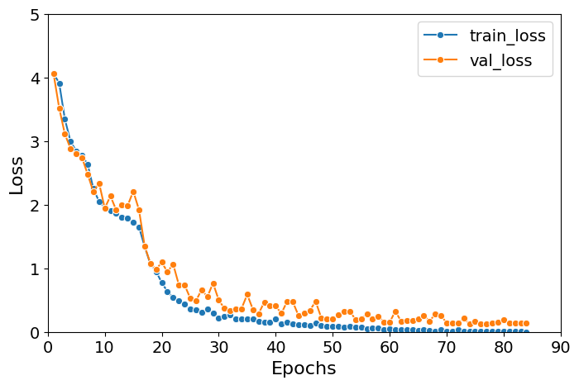
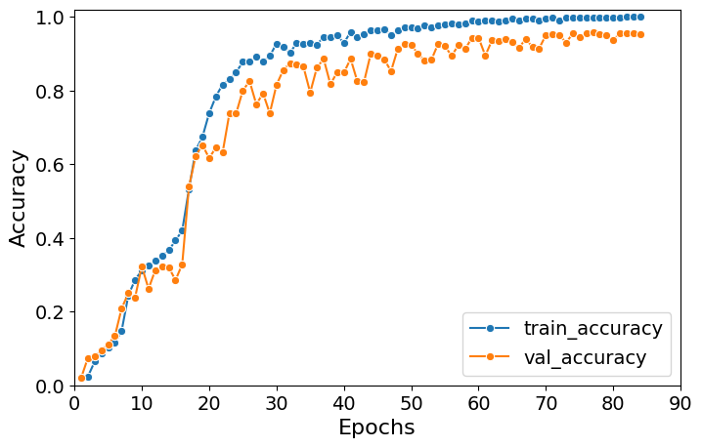
Results of 3D-ConvNeXt Model
Model Name | Batch Size | No. of parameters | Optimizer | Initial learning rate | LR Scheduler | Weight decay | Early Stopping
3D ConvNeXt | 64 | ~2.8 M (~ 28.6 M for 2D) | adamw | 0.0005 | Warm-Up with Cosine Anneal | 0.05 | Yes (p10*)
Epochs | Time/Epoch | Memory | Training acc. | Validation acc. | Test acc. | Precision | Recall
84/100 | 270 sec | 12227/16384 MiB* | 1.00 | 0.954 | 0.94 | 0.94 | 0.94
Learning Curves
Figure 11 – Learning Curves for 3D-ConvNeXt model
*p5/p10 – patience of 5/10 epochs, *MiB – Mebibyte (1,048,576 bytes)

Slide 17
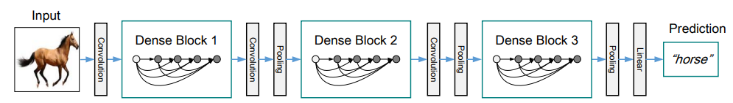
3D-DenseNet Model
Main Modifications done for 3D-DenseNet model
Kernel size, Stride & Padding in the top layer.
The growth rate (k) parameter is reduced from 32 to 6.
2D DenseNet-121
DenseNet-121 | Original 2D DenseNet-121 (k=32) | Output size of DenseNet-121 | 3D-DenseNet (k=6) | Output size of 3D-DenseNet
Input |  | 224 x 224 x 3 |  | 56 x 56 x 147 x 1
Conv1 | 7×7, 64, stride 2, padding 3 | 112 x 112 x 64 | 3x3x3, 64, stride (2,1,1), padding 1 | 56 x 56 x 74 x 64
Max Pool | 2x2, stride 2, padding 0 | 56 x 56 x 64 | 2x2x2, stride 2, padding 0 | 28 x 28 x 37 x 64
Dense Block 1 | [1×1, 4k, s1, p0 3×3, k, s1, p1] x 6 | 56 x 56 x 256 | [1×1x1, 4k, s1, p0 3×3x3, k, s1, p1] x 6 | 28 x 28 x 37 x 100
Transition Layer 1 | conv(1x1,128,s1,p0) | 28 x 28 x 128 | conv(1x1x1,50,s1,p0) | 14 x 14 x 18 x 50
 | Avg pool(2x2,s2,p0) |  | Avg pool(2x2x2,s2,p0)
Dense Block 2 | [1×1, 4k, s1, p0 3×3, k, s1, p1] x 12 | 28 x 28 x 512 | [1×1x1, 4k, s1, p0 3×3x3, k, s1, p1] x 12 | 14 x 14 x 18 x 122
Transition Layer 2 | conv(1x1,256,s1,p0) | 14 x 14 x 256 | conv(1x1x1,61,s1,p0) | 7 x 7 x 9 x 61
 | Avg pool(2x2,s2,p0) |  | Avg pool(2x2x2,s2,p0)
Dense Block 3 | [1×1, 4k, s1, p0 3×3, k, s1, p1] x 24 | 14 x 14 x 1024 | [1×1x1, 4k, s1, p0 3×3x3, k, s1, p1] x 24 | 7 x 7 x 9 x 205
Transition Layer 3 | conv(1x1,512,s1,p0) | 7 x 7 x 512 | conv(1x1x1,102,s1,p0) | 3 x 3 x 4 x 102
 | Avg pool(2x2,s2,p0) |  | Avg pool(2x2x2,s2,p0)
Dense Block 4 | [1×1, 4k, s1, p0 3×3, k, s1, p1] x 16 | 7 x 7 x 1024 | [1×1x1, 4k, s1, p0 3×3x3, k, s1, p1] x 16 | 3 x 3 x 4 x 198
Classifier | average pool | 1 x 1 x 1024 | average pool | 1 x 1 x 1 x 198
 | flatten | 1024 | flatten | 198
 | linear | 1000 | linear | 50
Figure 12 – The 3D-DenseNet Architecture

Slide 18
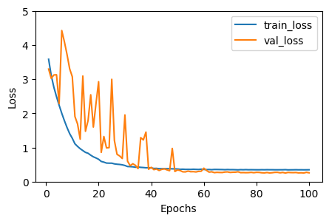
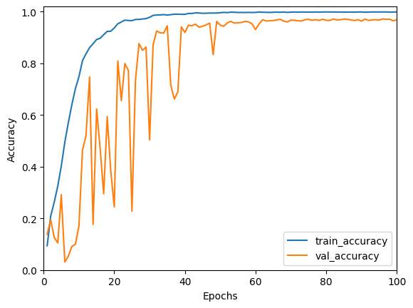
Results of 3D-DenseNet Model
Model Name | Batch Size | No. of parameters | Optimizer | Initial learning rate | LR Scheduler | Weight decay | Early Stopping
3D DenseNet | 32 | ~.45 M (~ 8 M for 2D) | sgd | 0.0005 | StepLR (0.5, 10 epochs) | 0.025 | Yes (p10*)
Epochs | Time/Epoch | Memory | Training acc. | Validation acc. | Test acc. | Precision | Recall
100/100 | 220 sec | 15227/16384 MiB* | 0.999 | 0.969 | 0.977 | 0.98 | 0.98
Learning Curves
Figure 13 – Learning Curves for 3D-DenseNet model
*p5/p10 – patience of 5/10 epochs, *MiB – Mebibyte (1,048,576 bytes)

Slide 19

3D-Resnet Model
2D Resnet-34
Main Modifications done for 3D-Resnet model
Kernel size, Stride & Padding in the top layer
The number of channels in each block reduced by 1/4th.
ResNet-34 | 2D ResNet-34 | Output size of 2D ResNet-34 | 3D-ResNet | Output size of 3D-ResNet
Input |  | 224 x 224 x 3 |  | 56 x 56 x 147 x 1
Conv1 | 7×7, 64, stride 2, padding 3 | 112 x 112 x 64 | 3x3x3, 64, stride (2,1,1), padding 1 | 56 x 56 x 74 x 64
Max Pool | 3x3, stride 2, padding 1 | 56 x 56 x 64 | 3x3x3, stride 2, padding 1 | 28 x 28 x 37 x 64
Block1 | [3×3, 64, p1, s1 3×3, 64, p1,s1] x 3 | 56 x 56 x 64 | [3×3x3, 16, p1,s1 3×3x3, 16, p1,s1] x 3 | 28 x 28 x 37 x 16
Block2 | [3×3, 128, p1,s1 3×3, 128, p1,s1] x 4 | 28 x 28 x 128 | [3×3x3, 32, p1,s1 3×3x3, 32, p1,s1] x 4 | 14 x 14 x 19 x 32
Block3 | [3×3, 256, p1,s1 3×3, 256, p1,s1] x 6 | 14 x 14 x 256 | [3×3x3, 64, p1,s1 3×3x3, 64, p1,s1] x 6 | 7 x 7 x 10 x 64
Block4 | [3×3, 512, p1,s1 3×3, 512, p1,s1] x 3 | 7 x 7 x 512 | [3×3x3, 128, p1,s1 3×3x3, 128, p1,s1] x 3 | 4 x 4 x 5 x 128
Classifier | average pool | 1 x 1 x 512 | average pool | 1 x 1 x 1 x 128
 | flatten | 512 | flatten | 128
 | linear | 1000 | linear | 50
Figure 14 – The 3D-ResNet Architecture

Slide 20
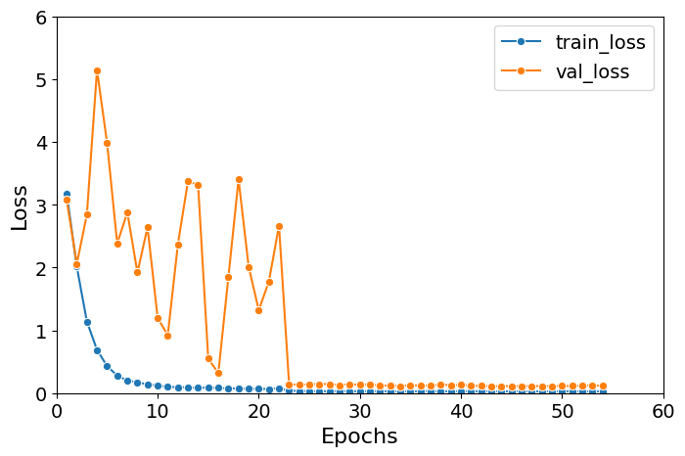
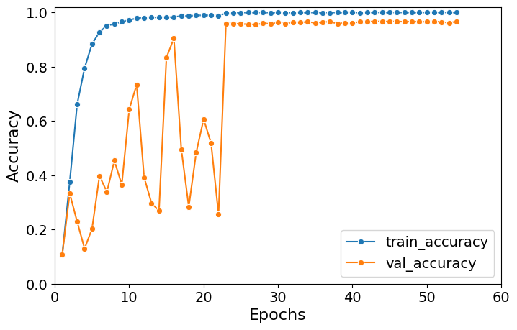
Results of 3D-Resnet Model
Model Name | Batch Size | No. of parameters | Optimizer | Initial learning rate | LR Scheduler | Weight decay | Early Stopping
3D ResNet | 64 | ~ 4M (~ 21.8 M in 2D) | sgd | 0.001 | ReduceLROnPlateau (0.1, p5*) | 0.01 | Yes (p10*)
Epochs | Time/Epoch | Memory | Training acc. | Validation acc. | Test acc. | Precision | Recall
54/100 | 180 sec | 15875/16384 MiB* | 0.999 | 0.967 | 0.985 | 0.99 | 0.98
Learning Curves
Figure 15 – Learning Curves for 3D-ResNet model
*p5/p10 – patience of 5/10 epochs, *MiB – Mebibyte (1,048,576 bytes)

Slide 21

Thank You

